Slide 1
Gender Recognition by Voice and Speech Analysis
Imran

Slide 2
Approach
1) Define – What is the problem statement?
2) Prepare – Obtain the data and cleanse it
3) Analyse – Analyse the data and create a model which targets the problem
4) Deliver – Propose a model to address the problem

Slide 3
Using machine learning techniques, can we design a model which is able to classify a person’s gender by their voice?

Slide 4
Background of the data
This dataset was based upon acoustic properties of the voice and speech to see if it can be used in a model to identify a voice as male or female.
The dataset consists of 3,168 recorded voice samples, collected from male and female speakers.
The voice samples have been pre-processed by acoustic analysis in R using the seewave and tuneR packages, with an analyzed frequency range of 0hz-280hz (human vocal range).
https://www.kaggle.com/primaryobjects/voicegender
We shall now take a look at the processed data and analyse it and apply it to a machine learning algorithm.

Slide 5
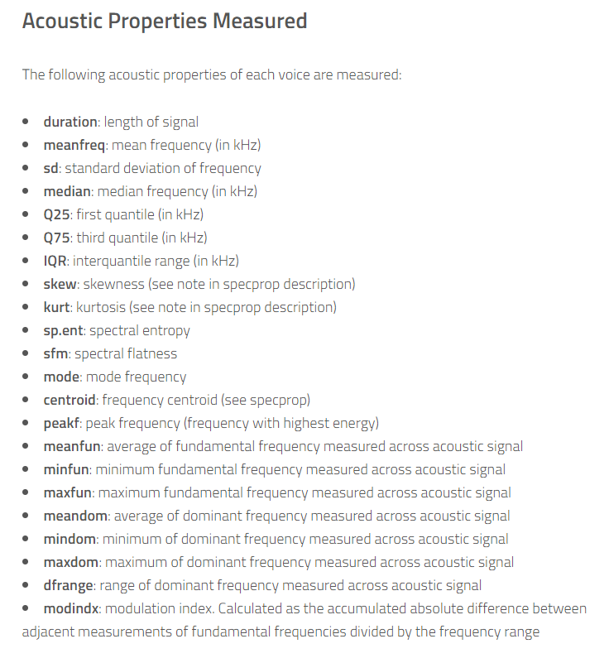
Data preparation
Understanding the data (20 features)

Slide 6
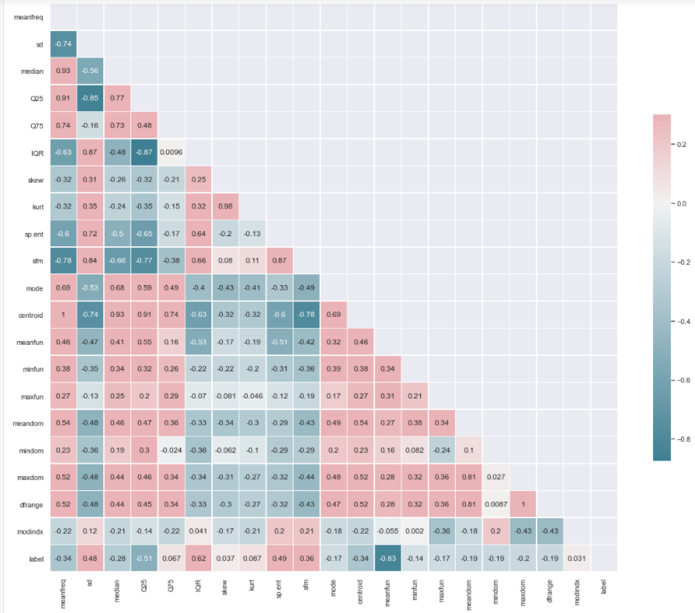
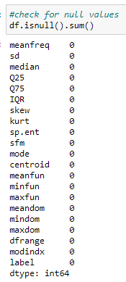
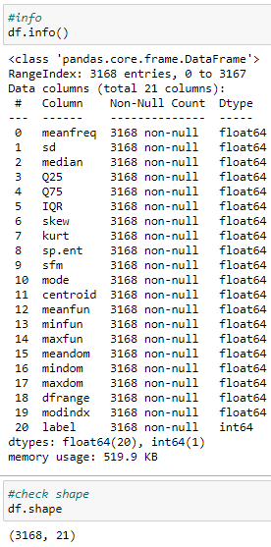
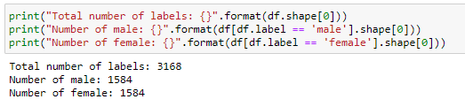
EDA – checking dataset
Balanced

Slide 7
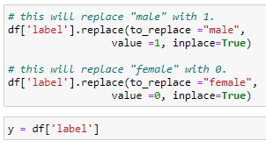
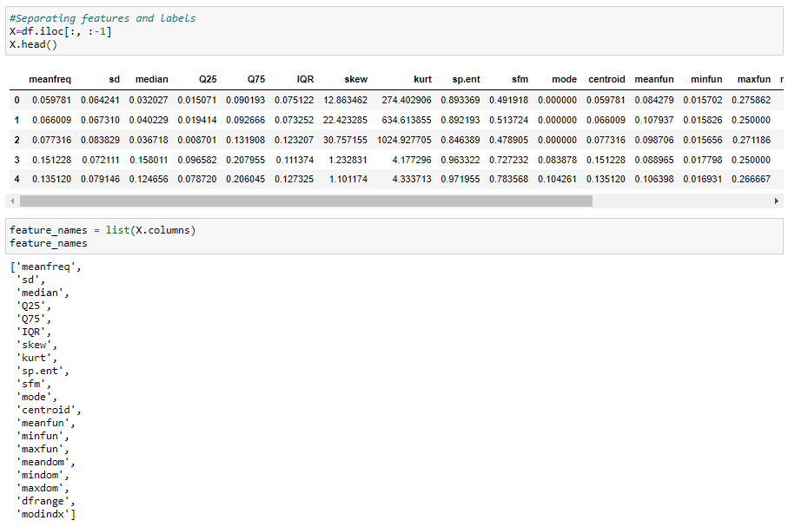
EDA – target and predictors

Slide 8
Models
We shall now see which of the following 3 models will obtain the best result:
Logistic Regression
Support Vector Machine
K-NN

Slide 9
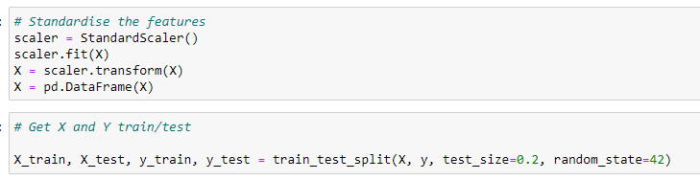
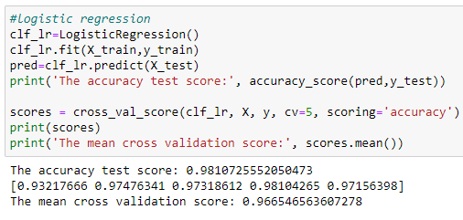
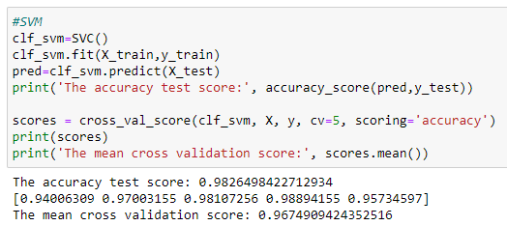
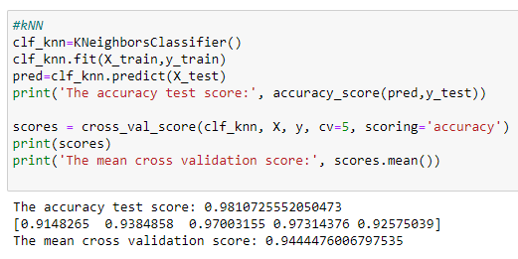
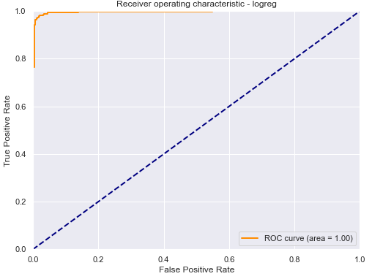
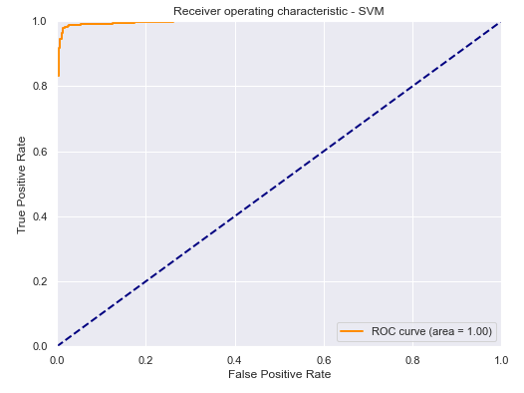
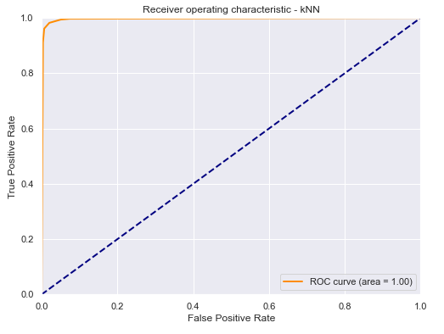
Initial comparisons

Slide 10
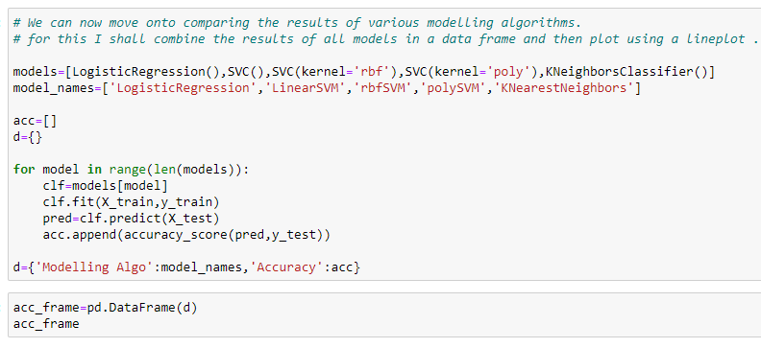
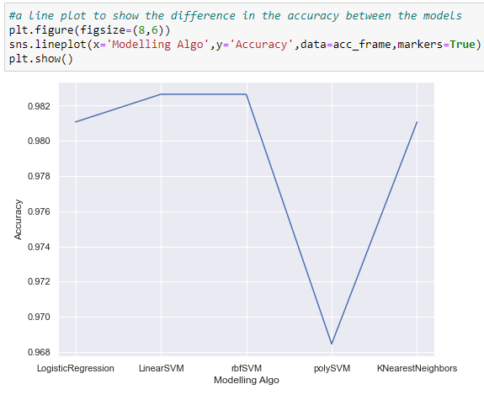
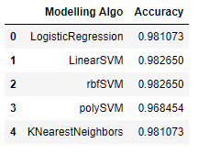
Comparing Models

Slide 11
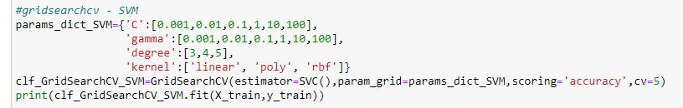


Parameter tuning - SVM
Accuracy improved by 0.002!

Slide 12
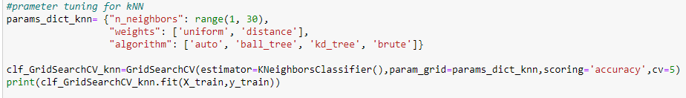


Prameter tuning - kNN
No change

Slide 13
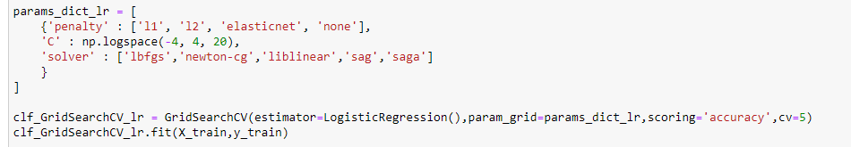
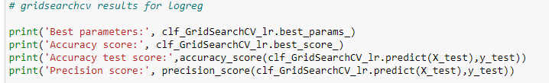

Parameter tuning – Logistic Regression
Performed slightly poorer

Slide 14
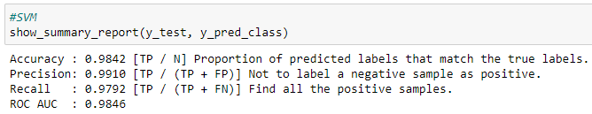
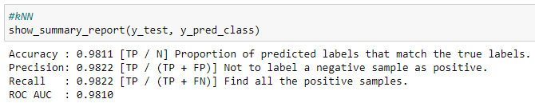
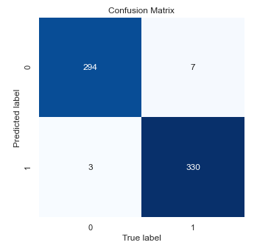
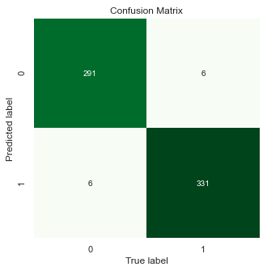
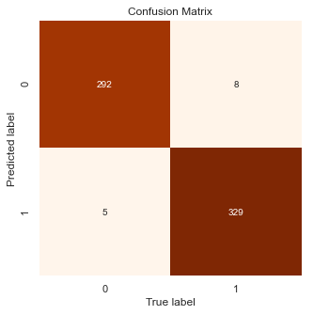
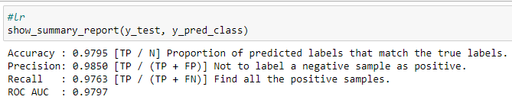
Overall Comparison
SVM has the best accuracy and precision of amongst the 3 models.

Slide 15
Proposed Solution & further considerations
All models actually produced good accuracy and precision scores and the increments in the scores between them are minimal
The SVM ‘rbf’ model produces the model with the best accuracy, precision scores and ROC AUC.
Is there any further way to improve the model? – Feature Selection

Slide 16
Using forward feature selection method
The forward selection method:
Keeps a list of selected features
Keeps a list of features still available for selection
Loops through available features:
  Calculates added value for each feature (using stratified k-fold validation)
  Selects feature that adds most value
  Adds selected feature to selected features list and removes it from available features list
This method uses a while loop to keep exploring features until no more are available.

Slide 17
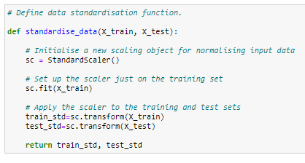
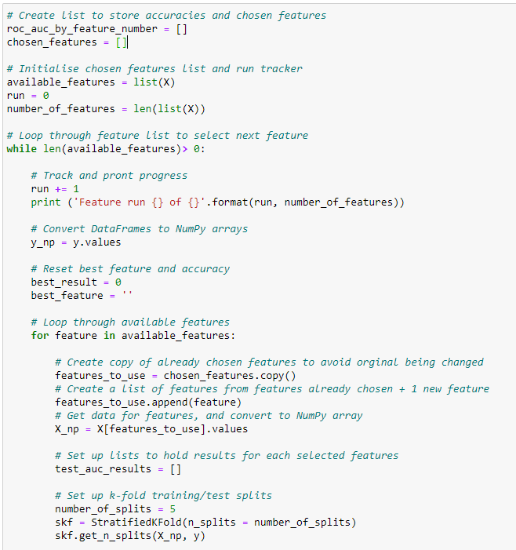
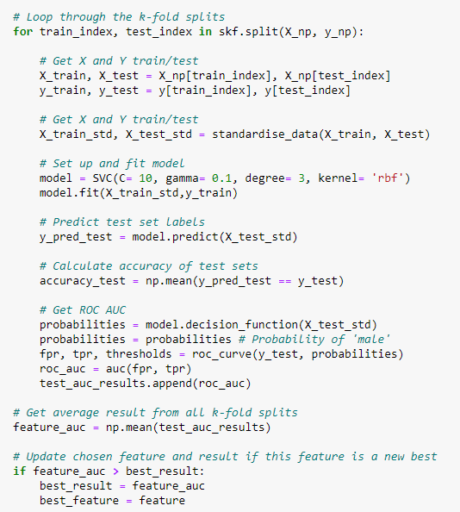
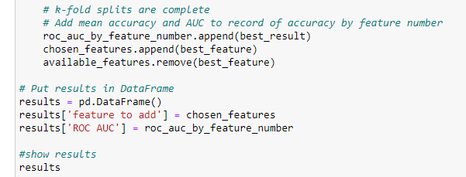
Forward Feature selection (Stratified k-fold)

Slide 18
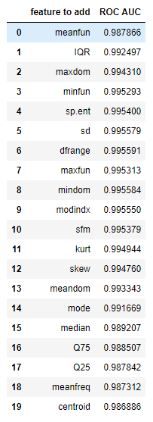
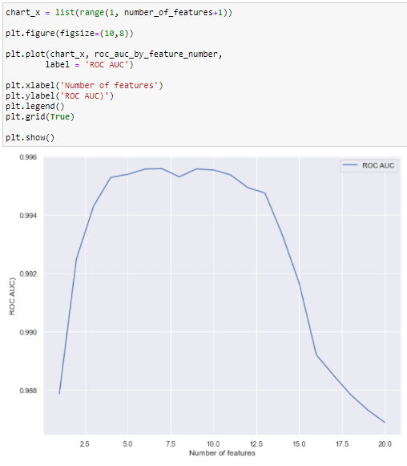
Other Considerations

Slide 19
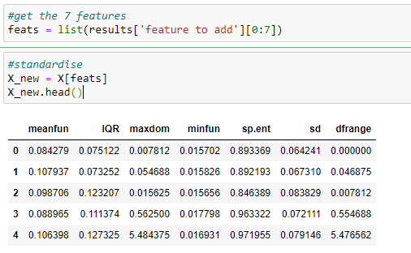
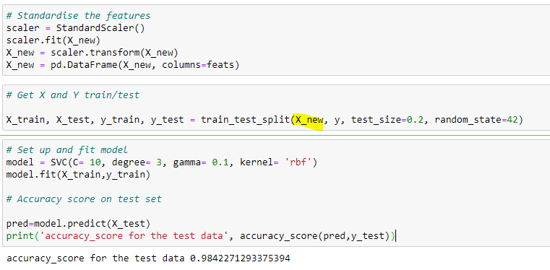
SVM – (7 features only)
Same score as the old model

Slide 20
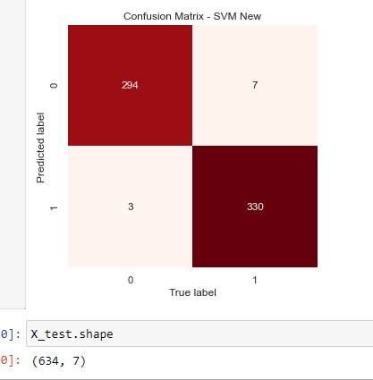

SVM(20 features) vs SVM (7 features)
Noted a reduction in features, but preserving the same scores.

Slide 21
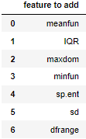
Conclusion
Hence, I would propose to use the new model – lesser features, same results.
Other thoughts:
  – possibly could perform the same feature selection techniques on the weaker models and check if a reduction in features leads to any improved performance.
  Consider removing outliers which may affect the model

Slide 22
THE END

